Slide 1
Circuit Board Designer -
Final Presentation
Kenneth Shipley, Joseph Spear, and Jason Rivas

Slide 2
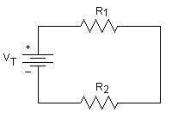
Introduction and Purpose
Today’s modern world is founded on the principles of electrical circuits and electronics. Without them, we wouldn’t have light bulbs, heating and cooling, computers, and many other luxuries that we have today.
Developing functional circuits and clean looking diagrams can be a hassle.
In many cases, there is a huge difference between circuit diagrams and physical PCB layouts, which can cause big problems in converting from one to another.

Slide 3
Software Overview
This program provides the user with the ability to produce basic circuit diagrams quickly and easily.
It also provides the user the ability to convert their diagram to a physical PCB layout which is optimized.
The program outputs an image of the optimized PCB layout for use in any further electrical application.

Slide 4
Technologies
The technologies included in this program are:
Programs:
Visual Studio Code Editor
QT Designer
Python 3
Libraries:
PyQT Library
PySide2 (PyQT fork) Library
Numpy Library
XML Library
JSON Library
PIL (Python Imaging Library)/Pillow (PIL fork)

Slide 5
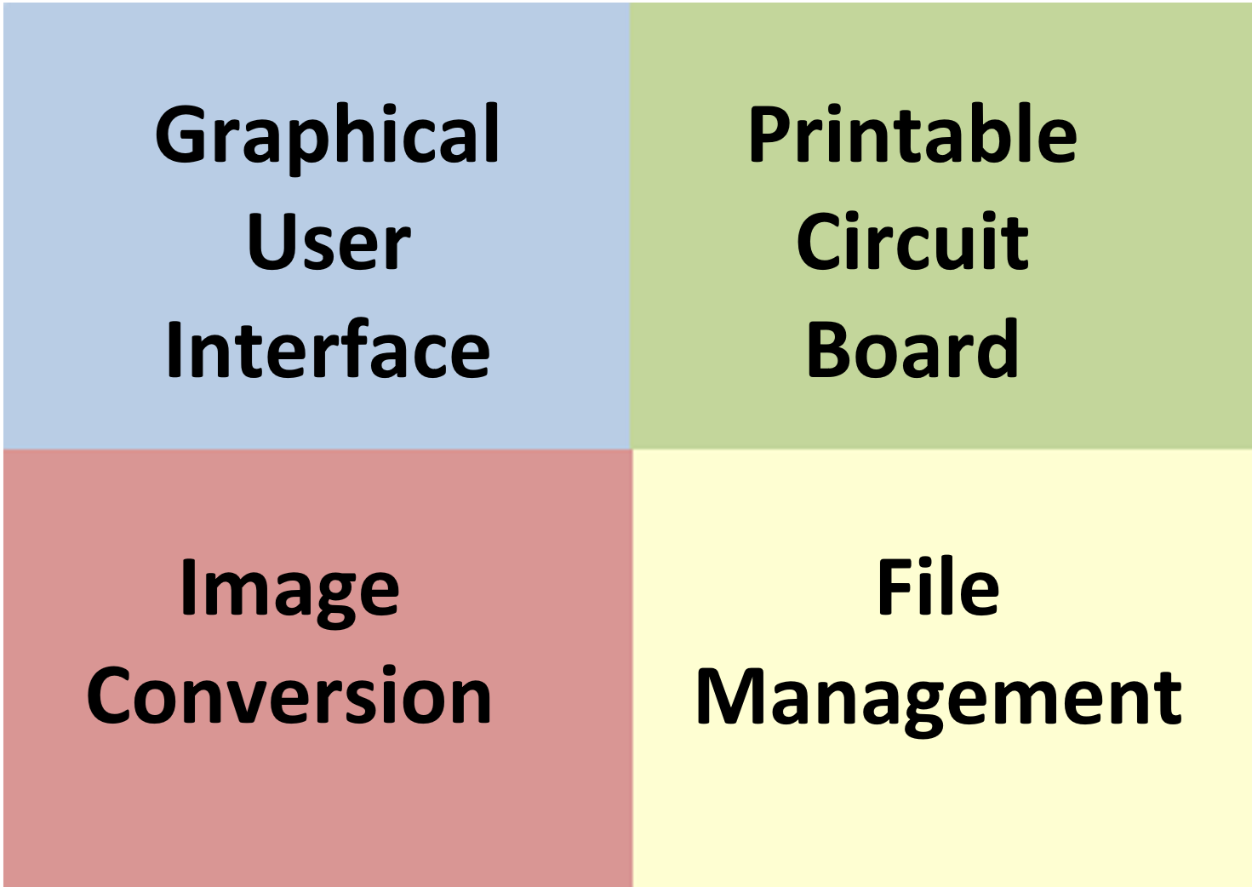
Software breakdown
This software is broken up into four main sections:
Graphical User Interface
PCB Optimization
Image Construction
File Management

Slide 6

Graphical User Interface
One of the key features of the Circuit Board Designer is the simple yet comprehensive Graphical User Interface.
The GUI is broken up into three main pages:
Start Menu / File Menu
Circuit Building Workspace
Convert Menu
All GUI implementation was done using PyQT.

Slide 7
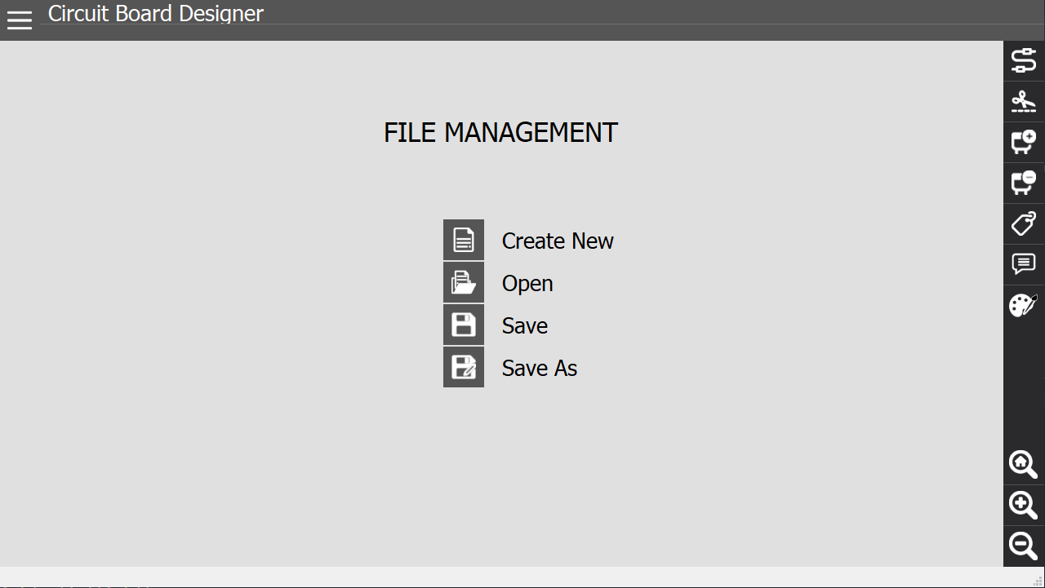
GUI - File Menu
The File Menu page is the initial page which opens when you start the program.
The File Menu includes the following functions:
Create New
Open
Save
Save As

Slide 8
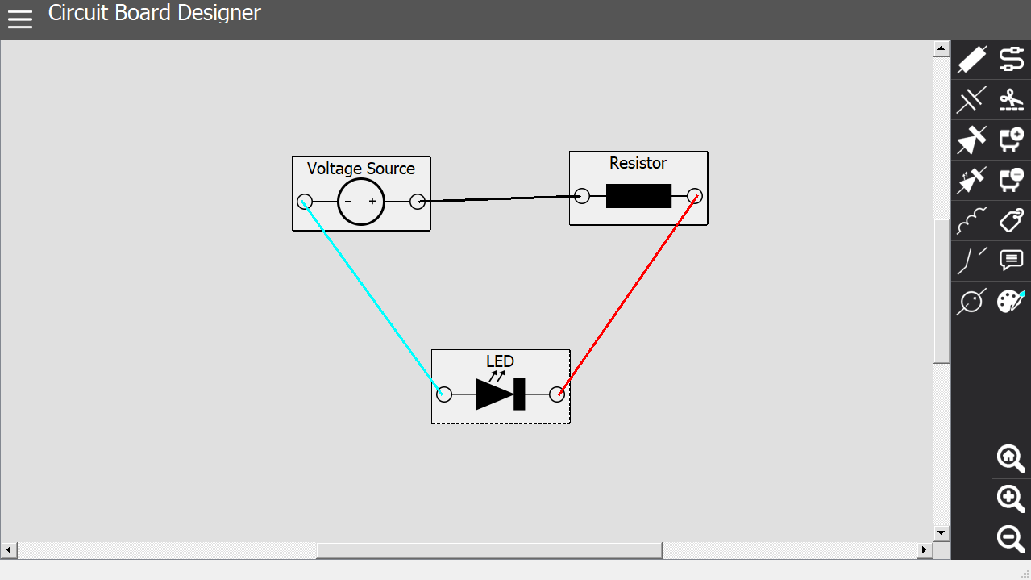
GUI - Circuit Building Workspace
The Circuit Building Workspace is the main GUI page. This is where the actual circuit building takes place.
The functions on the right tab are:
Wire
Wire Snipper
Add Component
Subsequent components are shown on a second tab
Delete Component
Add Label
Comment (Not Implemented)
Color
Subsequent Colors are shown on a second tab

Slide 9
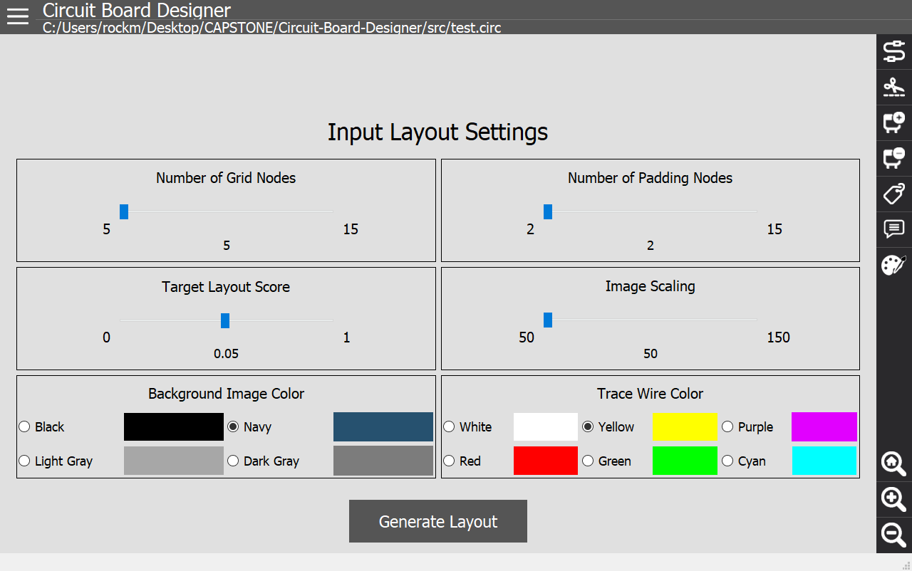
GUI - Convert Menu
The Convert Menu is where the users input will be able to be converted from a circuit diagram into a physical PCB layout.
The functions here are:

Slide 10
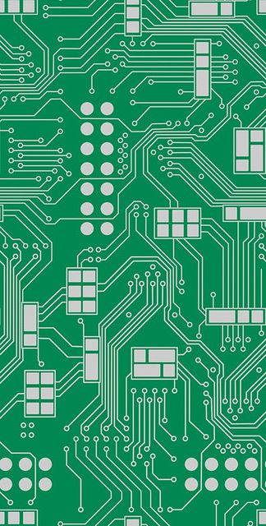
PCB Optimization
The second feature of Circuit Board Designer is converting the circuit diagram input from the user into an optimized physical layout for a PCB.
This is done by using two common computational techniques:
Monte Carlo Algorithm
A-Star (A*) Algorithm

Slide 11
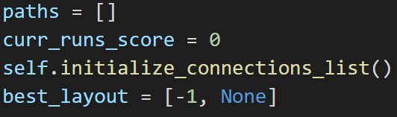
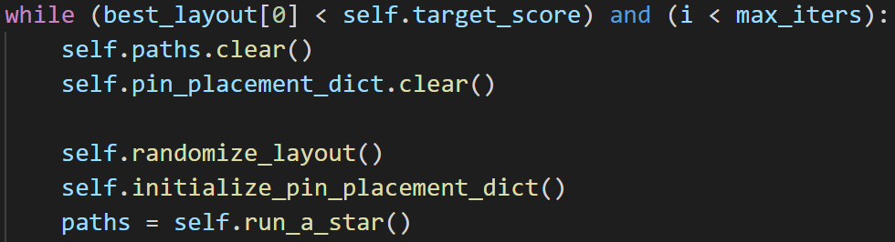
PCB Optimization - Monte Carlo

Slide 12
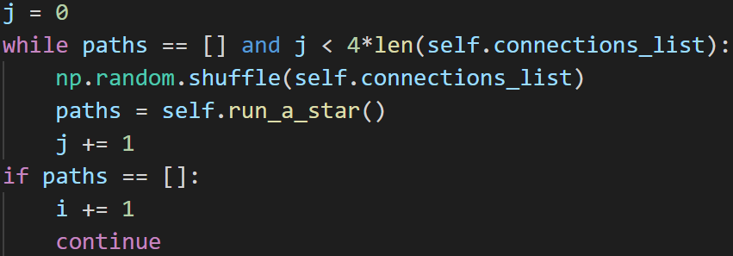
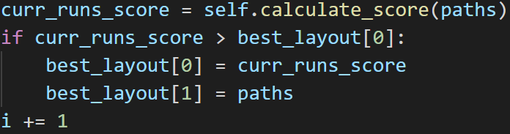
PCB Optimization - Monte Carlo

Slide 13
PCB Optimization - A*
OPEN CLOSED add the start node to OPEN loop current = node in OPEN with the lowest f_cost remove current from OPEN add current to CLOSED if (current is the target node) return for each neighbour of the current node if (neighbour is not traversable) OR (neighbour is in CLOSED) skip to the next neighbour if (new path to neighbour is shorter) OR (neighbour is not in OPEN) set f_cost of neighbour set parent of neighbour to current if (neighbour is not in OPEN) add neighbour to OPEN

Slide 14
PCB Optimization - A*

Slide 15
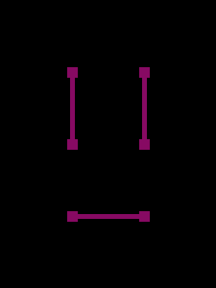
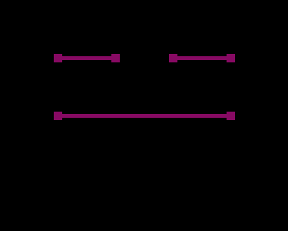
Image Construction
The final output of the Circuit Board Diagram is a set PCB Layout color coded however the user decides based on the Convert Menu options.
To the right are two different outputs from two circuits where there are are three components each.

Slide 16
File Management
PyQt offers its own way to save and open files.
Save, Save As, and Open all call the backend’s save and load methods as well.
Create New deletes the schematic instance and creates a new one.
.circ

Slide 17
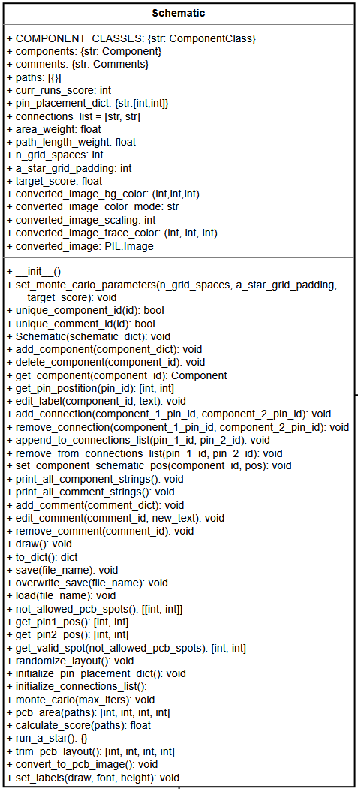
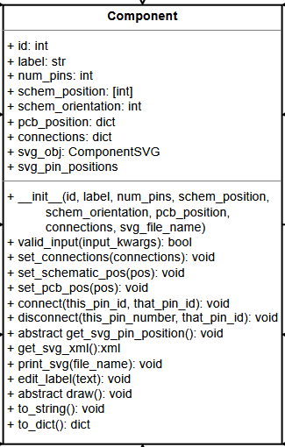
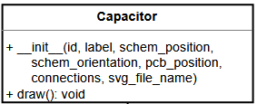
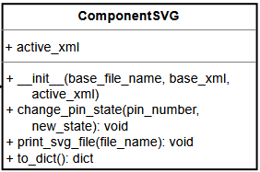
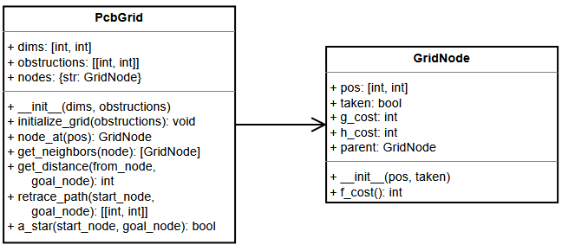

Backend Class Diagram
Backend Class Diagram Link

Slide 18
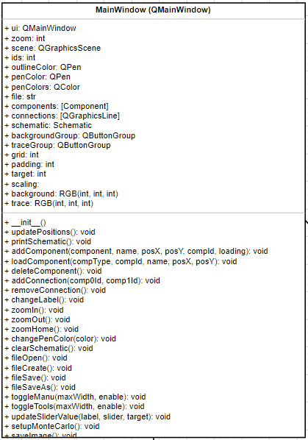
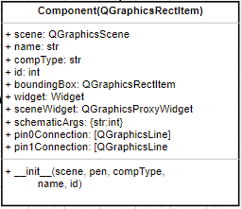
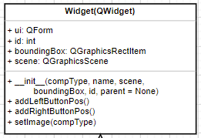
GUI Class Diagram
Class Diagram

Slide 19
Demonstration

Slide 20
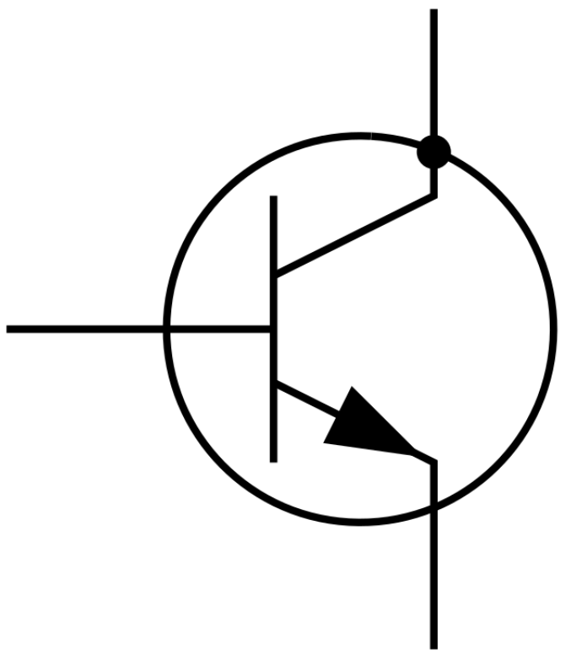
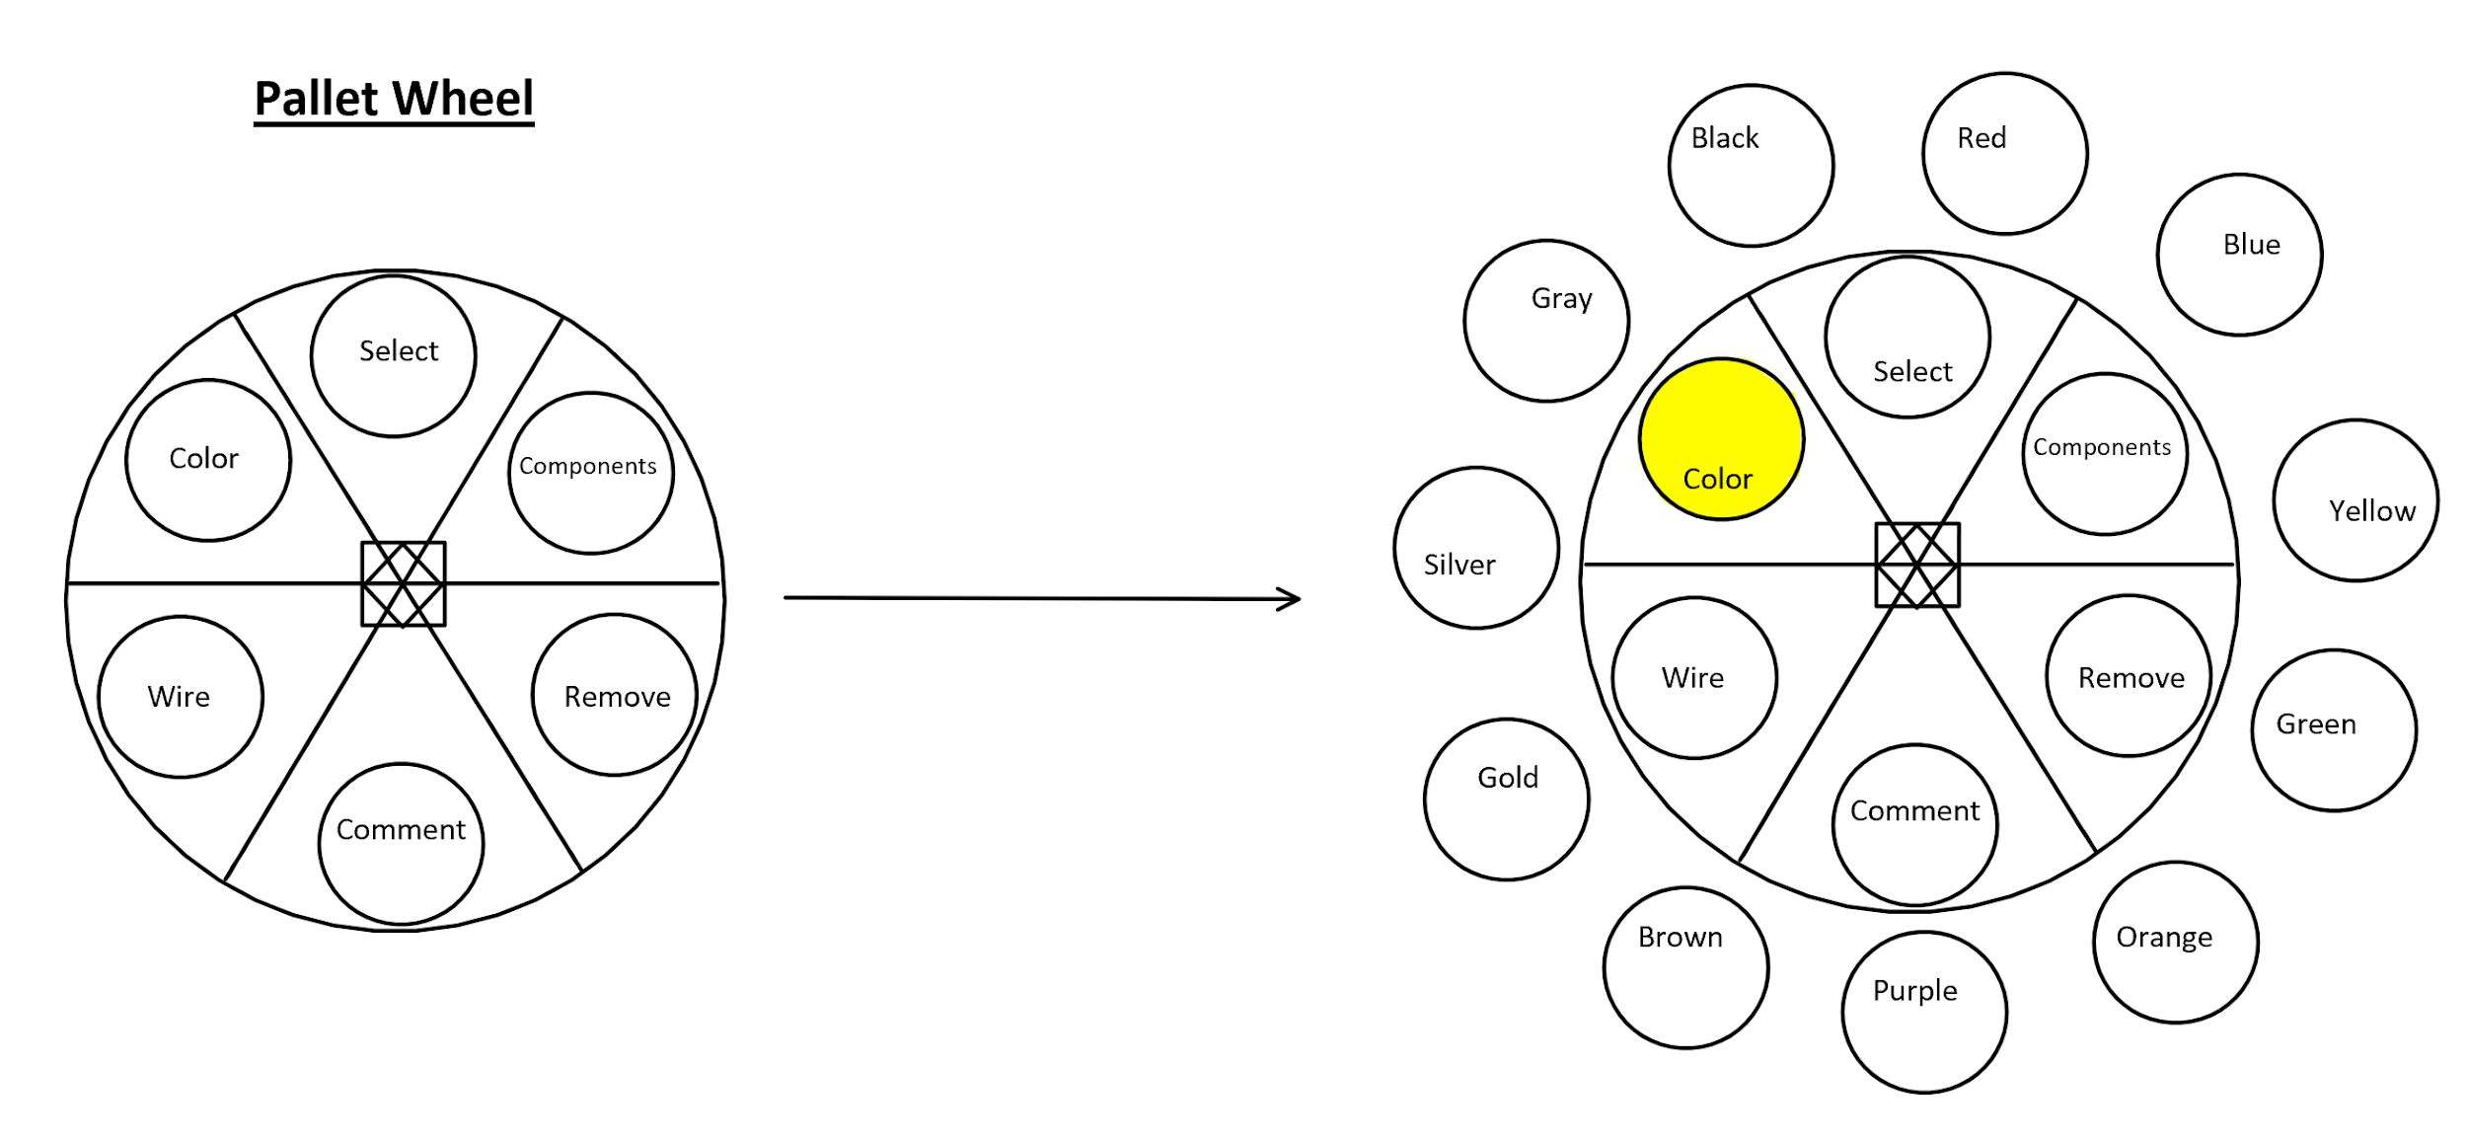
Future Works
Due to time constraints, some of the more complex features had to be omitted from version 1.0. In the event that version 2.0 was to be created, the following features would be implemented:
Pallet Wheel
Transistors
Comments
Follower Wires

Slide 21
Questions?

